Slide 1

Unit 4
DevOps & Software Engineering

Slide 2

Syllabus
DevOps & Software Engineering : Introduction to DevOps, DevOps Vs Traditional Software Development Models, DevOps Tools : Git, Docker, Selenium, Mavin, Puppet, Ansible, Kubernetes, Nagios, Fundamentals of testing, Objectives of Testing, Types of Testing, Levels of testing, Applications of software testing in IT companies, Career opportunities in the field of DevOps and software testing with skillset

Slide 3
Introduction to DevOps
DevOps combines development and operations to increase the efficiency, speed, and security of software development and delivery compared to traditional processes.
DevOps practices enable software development (dev) and operations (ops) teams to accelerate delivery through automation, collaboration, fast feedback, and iterative improvement.

Slide 4
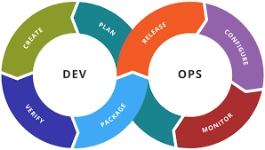

Slide 5
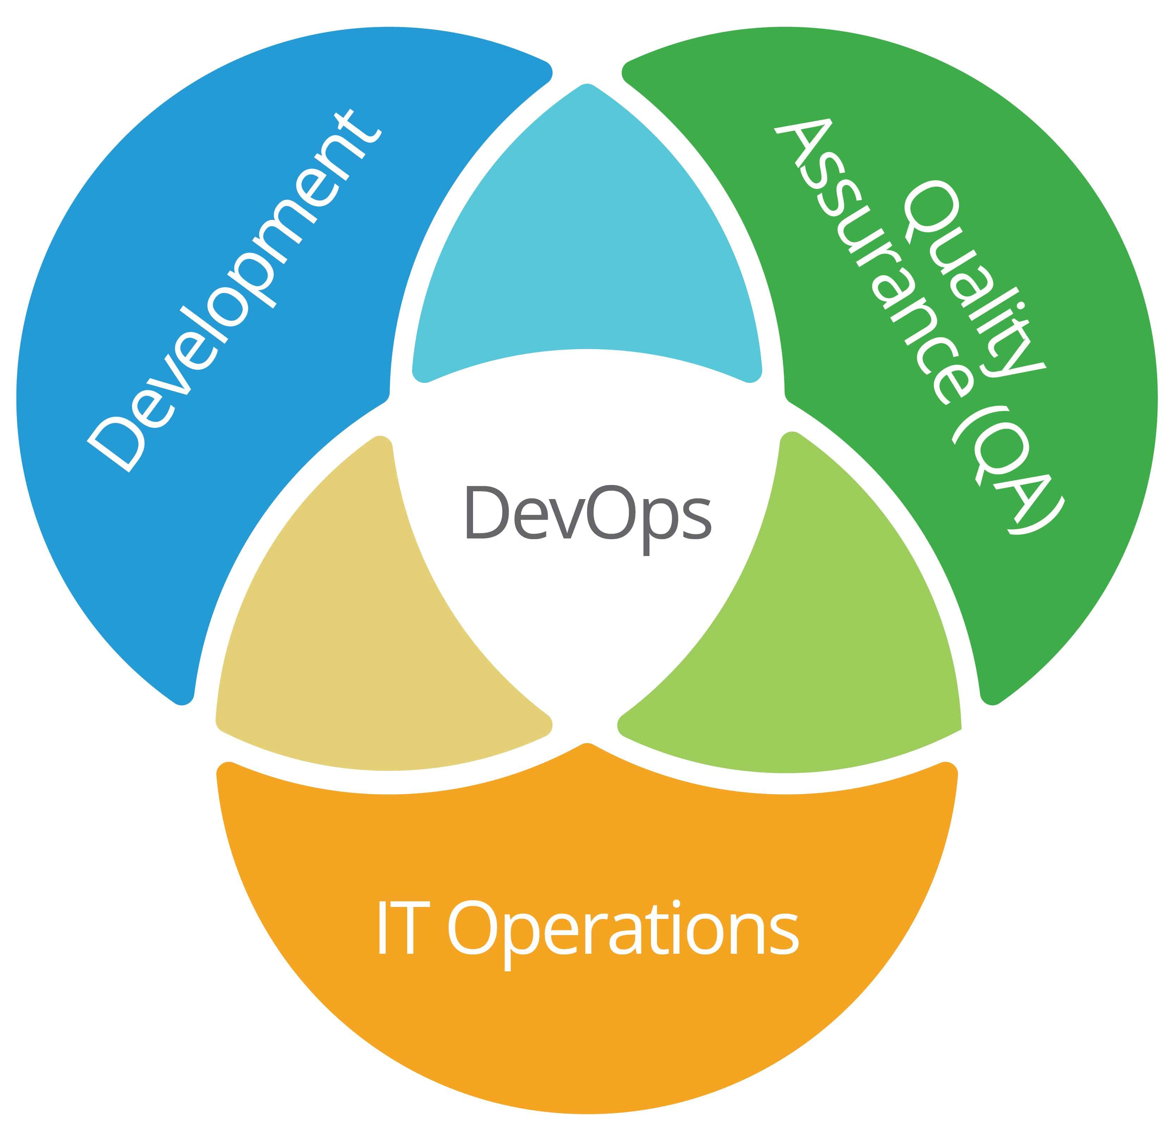

Slide 6
The word DevOps is a combination of the terms development and operations, meant to represent a collaborative or shared approach to the tasks performed by a company's application development and IT operations teams.

Slide 7
Motivation
One of the key benefits of introducing DevOps processes and culture is that it removes the communication barriers between teams, from an organization.
Therefore removes the reliance on the availability of an individual person or team in order for software delivery to progress.

Slide 8
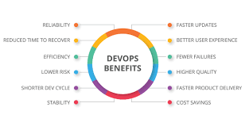

Slide 9
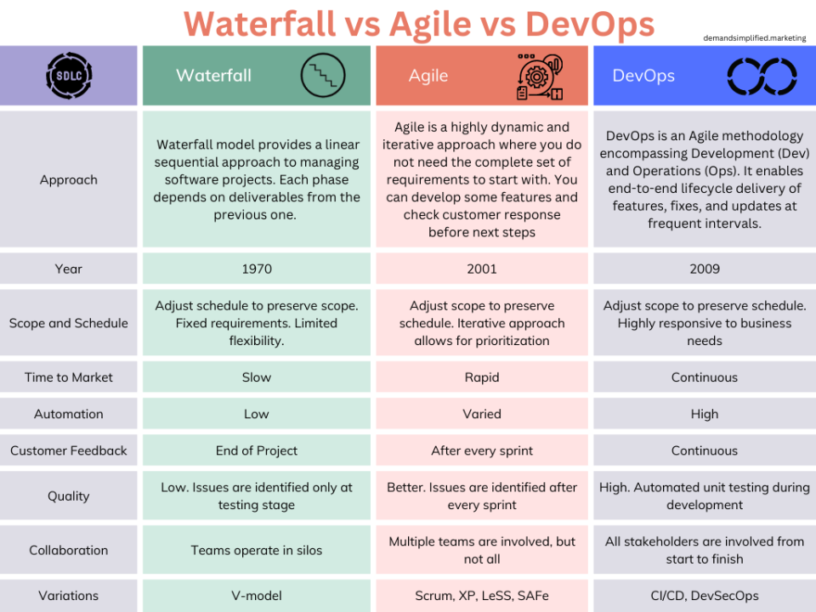
DevOps Vs Traditional Software Development Models

Slide 10
Real-life Applications of DevOps
1. Application of DevOps in the Online Financial Trading Company
The methodology in the process of testing, building, and development was automated in the financial trading company. Using the DevOps, deployment was being done within 45 seconds. These deployments used to take long nights and weekends for the employees. The time of the overall process reduced and the interest of clients increased.

Slide 11
2. Use of DevOps in Network cycling
Deployment, testing and rapid designing became ten times faster. It became effortless for the telco service provider to add patches of security every day, which used to be done only every three months. Through deployment and design, the new version of network cycling was being rolled out.
3. Application in Car Manufacturing Industries
Using DevOps, employees helped car manufacturers to catch the error while scaling the production, which was not possible before.

Slide 12
4. Benefits to Airlines Industries
With the benefit of DevOps, United Airlines saved $500,000 by changing to continuous testing standards. It also increased its coverage of code by 85%
5. Application to GM Financial
Regression testing time was reduced by 93%, which in turn reduced the funding period of load by five times.
6. Less Time for Integration
Key Bank used DevOps to reduce the time taken for the integration of security and compliance into the process from 3 months to 1 week.
7. Decreased Computation Cost and Operation Time
By the use of DevOps, Computation time has been dramatically reduced. In many cases, it has reduced the computing time from up to 60%. When the time taken to complete a task is decreased, then the cost involved the process also decreases.

Slide 13
8. Faster Development of Software
The DevOps helps in the faster delivery of apps because it ensures speedier delivery.
9. Improvement in Team Collaboration
Transparency is required for better decision-making and works better efficiency of resources. By using DevOps, teams can be more transparent in their work of developing applications and software. There are many big tasks of a project which are broken down into many small tasks that are allotted to different teams or people in the organisation.
10. Continuous Operation of Monitoring, Testing, Deployment, and Release
All of the requirements of delivering high-quality software, developing software applications in less time frame. Also, a minimum period to launch the software applications and short release cycles can only be fulfilled by the use of DevOps.

Slide 14
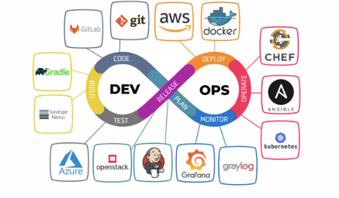
DevOps Tools

Slide 15
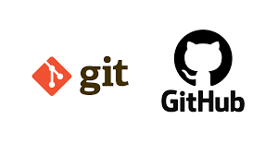
What is Git
Git is a DevOps tool used for source code management.
It is a free and open-source version control system used to handle small to very large projects efficiently.
Git is used to tracking changes in the source code, enabling multiple developers to work together on non-linear development.
Git is a version control system used for tracking changes in computer files. It is generally used for source code management in software development.

Slide 16
Features of Git
Tracks history
Free and open source
Supports non-linear development
Creates backups
Scalable
Supports collaboration
Branching is easier
Distributed development

Slide 17
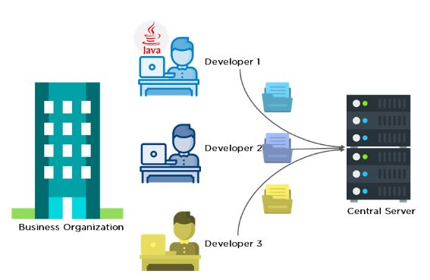
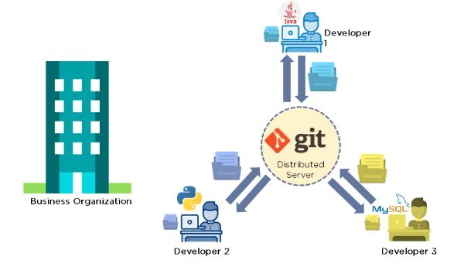
Before using Git
After Using Git

Slide 18
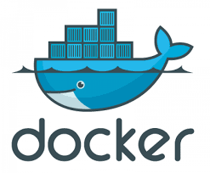
What is Docker
Docker is a tool to create, run and deploy containers.
Containers are isolated platforms to run our applications.
A great advantage to use docker containers is, to run any process without installing its binaries or dependencies on your servers. With only its Docker image you are good to go.
Docker is an open-source containerization system.
Docker is also useful for supporting applications with special needs, like older operating systems or libraries that conflict with other applications. Instead of keeping a new host for one application, you run it in a container.

Slide 19
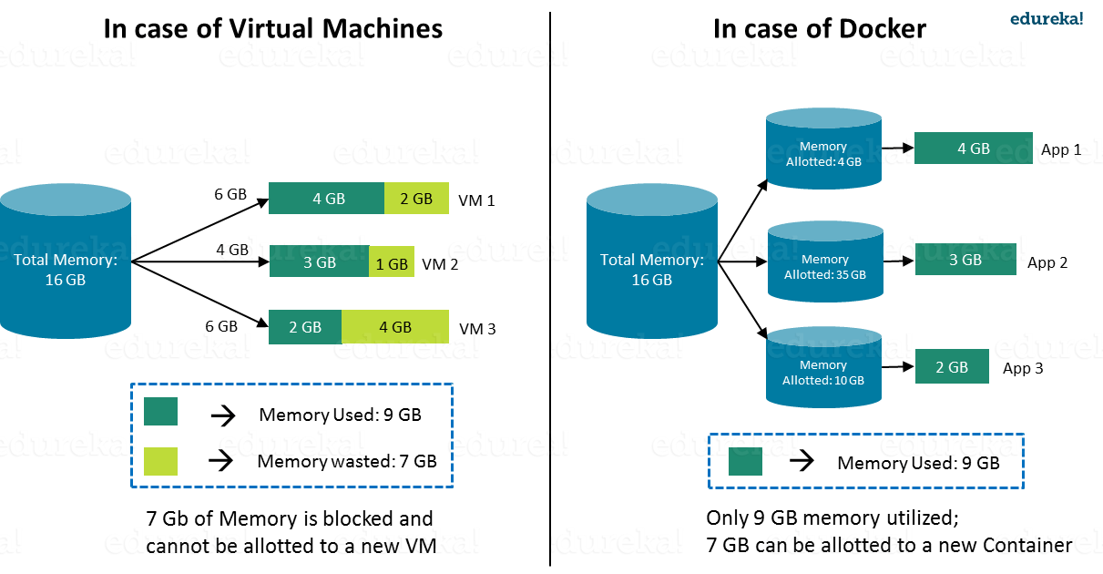

Slide 20
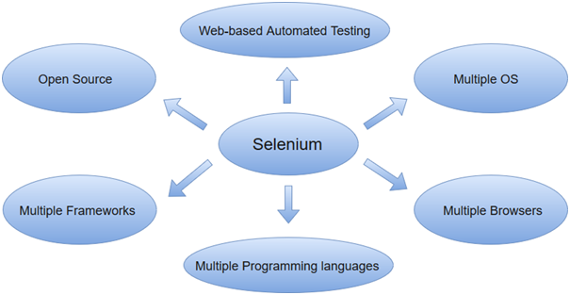
What is Selenium
Selenium is an open-source, automated testing tool used to test web applications across various browsers.
Selenium can only test web applications, unfortunately, so desktop and mobile apps can’t be tested.
However, other tools like Appium and HP’s QTP can be used to test software and mobile applications.

Slide 21
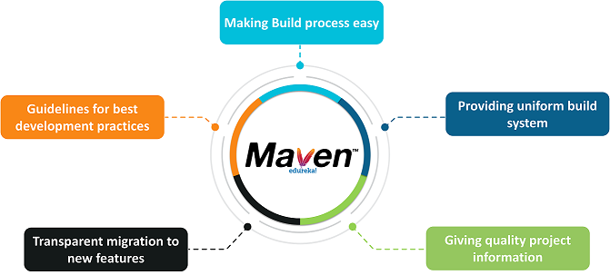
What is Maven
Maven is a software project management build tool based on Project Object Model (POM).
The tool is typically used for Java-based projects. Every Java project requires certain dependencies, which are automatically downloaded when running a Maven build.
This simplifies everyday tasks for Java developers and helps them with their projects.

Slide 22
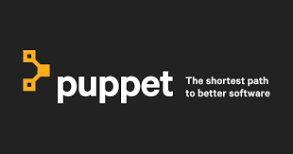
What is Puppet
Puppet is an open-source DevOps system management tool.
It is used to centralize and automate the configuration management procedure.
This tool is developed using Ruby DSL (domain-specific language). Puppet tool deploys, configures, and manages the servers.
Puppet is a DevOps configuration management tool.
This is developed by Puppet Labs and is available for both open-source and enterprise versions. It is used to centralize and automate the procedure of configuration management.

Slide 23
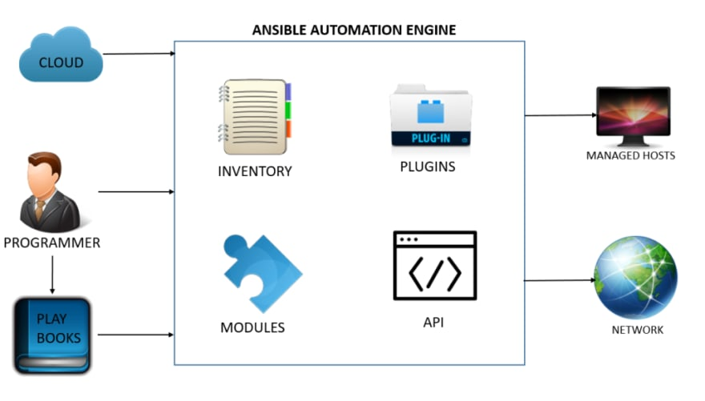
What is Ansible
Ansible is an open-source automation tool, or platform, used for IT tasks such as configuration management, application deployment, intraservice orchestration, and provisioning.
Automation is crucial these days, with IT environments that are too complex and often need to scale too quickly for system administrators and developers to keep up if they had to do everything manually.
Automation simplifies complex tasks, not just making developers’ jobs more manageable but allowing them to focus attention on other tasks that add value to an organization.
In other words, it frees up time and increases efficiency.

Slide 24
Benefits of Ansible
Free: Ansible is an open-source tool.
Very simple to set up and use: No special coding skills are necessary to use Ansible’s playbooks (more on playbooks later).
Powerful: Ansible lets you model even highly complex IT workflows.
Flexible: You can orchestrate the entire application environment no matter where it’s deployed. You can also customize it based on your needs.
Agentless: You don’t need to install any other software or firewall ports on the client systems you want to automate. You also don’t have to set up a separate management structure.
Efficient: Because you don’t need to install any extra software, there’s more room for application resources on your server.

Slide 25
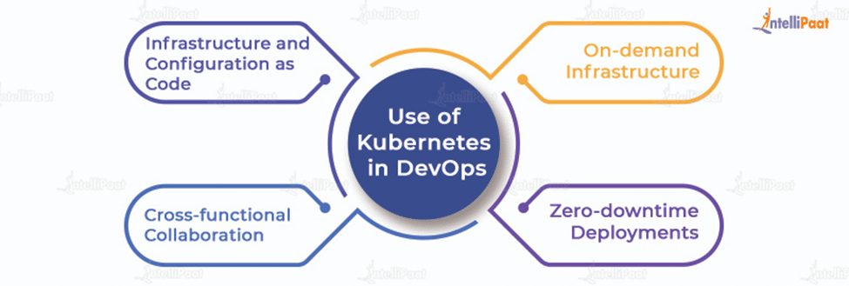
What is Kubernetes
Kubernetes, also known as K8s, is an open-source system for automating deployment, scaling, and management of containerized applications.
Kubernetes allows the construction of infrastructure as code.
Kubernetes offers self-service catalog functionality enabling the creation of infrastructure on-demand by developers.

Slide 26

What is Nagios
Nagios is a free and open-source software application for computer systems. It is used for monitoring the systems, networks and infrastructure.
Its original name was NetSaint developed by Ethan Galstad with the group of some developers in the year 1999.
This software application mainly provides the services of monitoring and alerting for switches, applications, and servers inside the DevOps culture.

Slide 27
Why Nagios?
Following are some reasons for using the Nagios software application:
It is used for monitoring the performance issues of servers.
It helps the users of this software application to easily find the root cause of any problem.
It is also used to detect all the possible networks.
We can easily maintain the issues of security and also detect the availability of the services.
This application automatically fix the problems or issues when occurs.
Users can easily run it on any operating system.
Before the failure of a system, it helps you to update the infrastructure.
Using this application, user can quickly detect any type of infrastructure issues.
It also monitors the various servers of database such as SQL Server, MySQL.

Slide 28
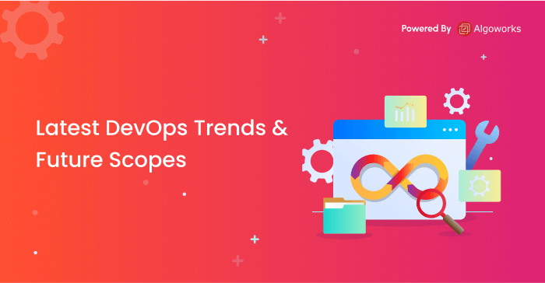
Current trends and opportunities

Slide 29
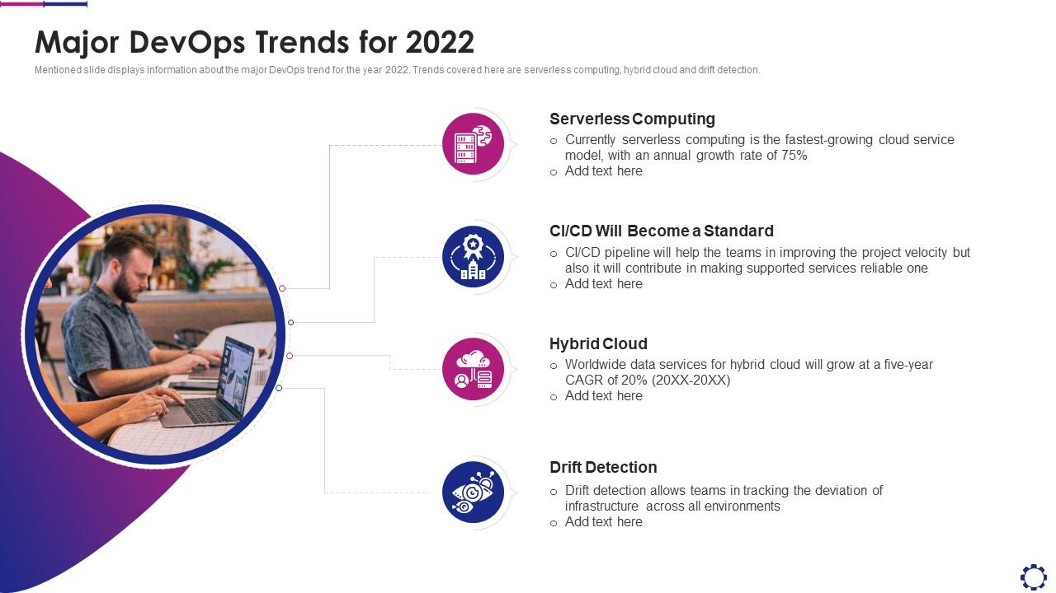

Slide 30
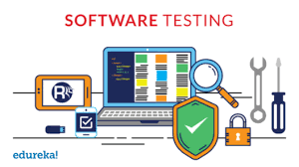
Fundamentals & Objectives of Testing

Slide 31
The objectives of the testing are the reasons or purpose of the testing and the object of the testing is the work product to be tested.
Testing objectives can differ depending on few factors as,
The context of the component
System being tested
The test level
The software development life cycle model

Slide 32
The basic goal of testing is to uncover as many flaws as possible in a software product while confirming whether or not the application meets the user’s needs.
Defects should be found as early in the testing cycle as feasible.

Slide 33
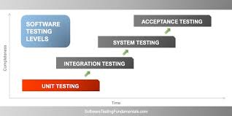
Types & Levels of testing,

Slide 34
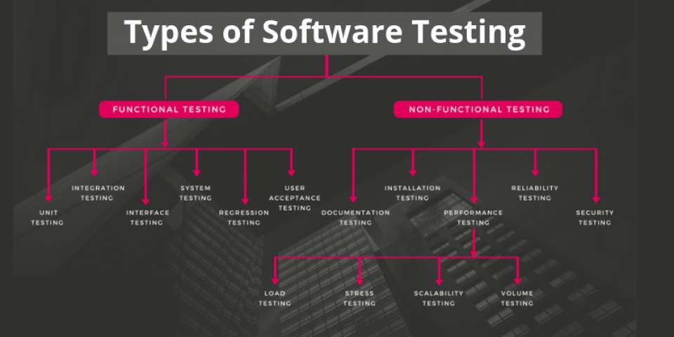

Slide 35
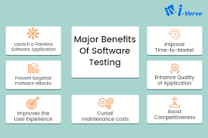
Applications of software testing in IT companies

Slide 36
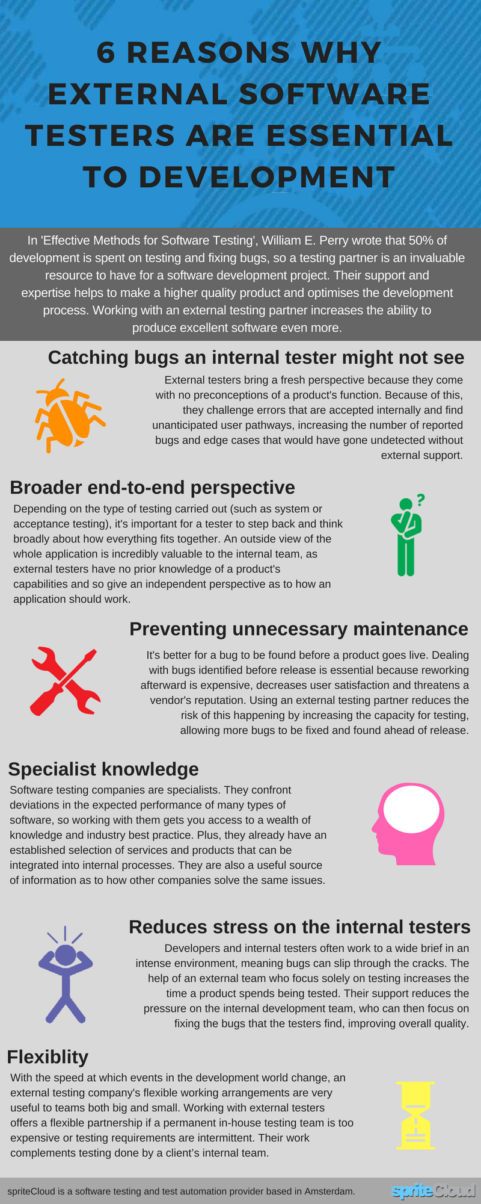

Slide 37
Career opportunities in the field of DevOps and software testing with skillset
1. DevOps Engineer
2. Site Reliability Engineer (SRE)
3. Security Engineer (DevSecOps)
4. Continuous Integration/Continuous Delivery Specialist (CI/CD Specialist)
5. Devops Consultant

Slide 38
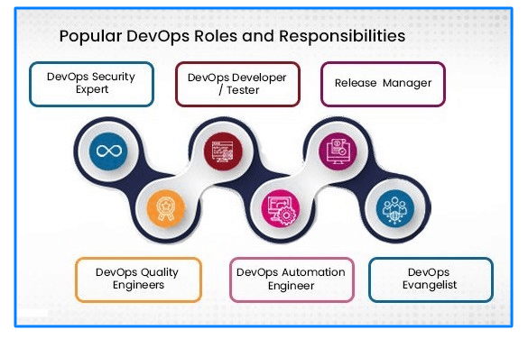
Job roles and skill set

Slide 39


Slide 40
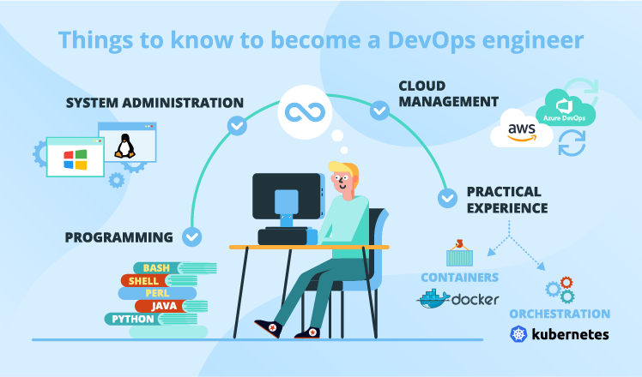

Slide 41
